Slide 1

HACK THE VERSE
HOSPITAL MANAGEMENT SYSTEM
BY TEAM
NOOB ENTITY

Slide 2


AGENDA
PROBLEM STATEMENT
SOLUTIONS BEING PROPOSED
APPROACH
USER CHARACTERISTICS
USE CASE DIAGRAM
CONCLUSION
TECH STACK
TEAM

Slide 3

PROBLEM STATEMENT
HMS will help us overcome all these problems because now patients can book their appointments at home, they can check whether the doctor they want to meet is available or not. Doctors can also confirm or decline appointments, this help both patient and the doctor because if the doctor declines’ appointment then patient will know this in advance and patient will visit hospital only when the doctor confirms’ the appointment this will save time and money of the patient. ​
​​

Slide 4


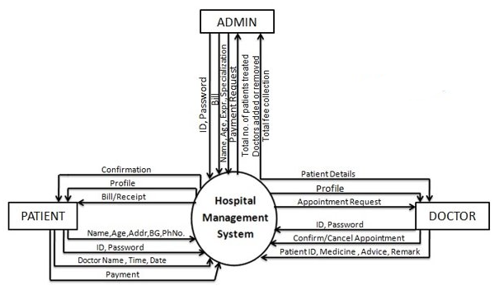

APPROACH

Slide 5
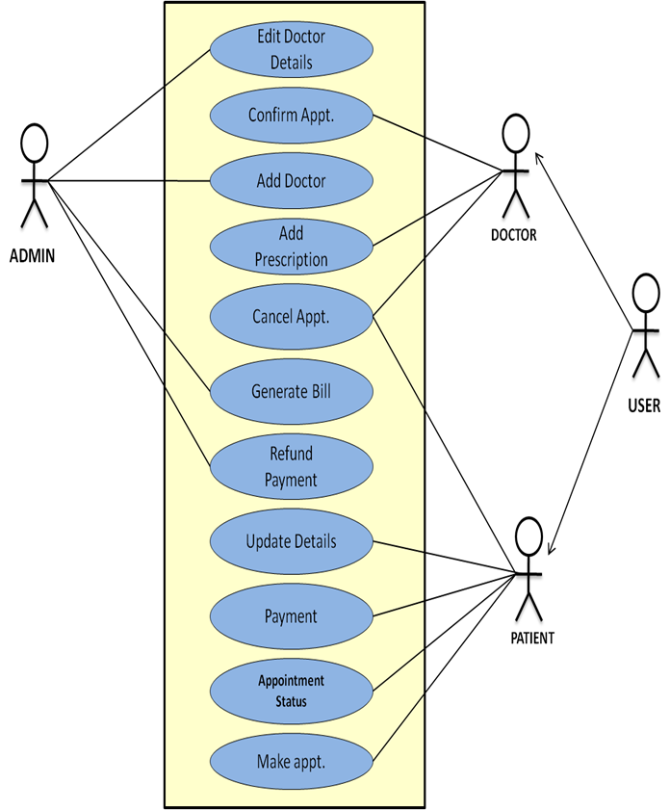
USE CASE DIAGRAM

Slide 6

TECH STACK
Database Management System (DBMS): Such as MySQL, PostgreSQL, or Microsoft SQL Server for storing patient records, billing information, etc.​
Programming Language: Often, languages like Java, C#, or Python are used for developing the software.​
Web Development Framework: If it's a web-based system, frameworks like Django (Python), Ruby on Rails, or ASP.NET may be used.​
Frontend Technologies: HTML, CSS, JavaScript, and possibly afrontend framework like React, Angular, or Vue.js.​

Slide 7

BEING PROPOSED
Patients on boarding
Diagnosis or lab tests reports status dashboard
Queries chatbot
Appointment booking
Reminders
Insurances suggestions
SOLUTION

Slide 8
USER CHARACTERISTICS
ADMIN
Access patient record , doctor record.​
Add new doctor entry in system database.​
Confirm payment and generate bill.​
View records.​

Slide 9
USER CHARACTERISTICS
PATIENT
Make appointment.​
Cancel appointment.​
Update details.​
Payment.​
View payment history.​
t

Slide 10


USER CHARACTERISTICS
DOCTOR
Confirmation of appointment.​
Cancellation of appointment.​
Modification of appointment list.​
Add prescription.​
t

Slide 11
CONCLUSION
The Hospital Management System (HMS) proves to be an indispensable tool for enhancing the efficiency and overall functionality of healthcare institutions. Through the automation of administrative tasks, streamlining patient records, and improving communication among healthcare professionals, the HMS significantly contributes to the delivery of high-quality patient care. The system not only reduces operational costs but also minimizes errors, ensuring a more accurate and timely provision of medical services ​.

Slide 12
THANK YOU

